Slide 1


DEEP LEARNING SERIES
Autoencoder Architectures & Generative Models
Feature Extraction, Denoising, and Variational Synthesis
Dr. Ahmed Yousry

Slide 2
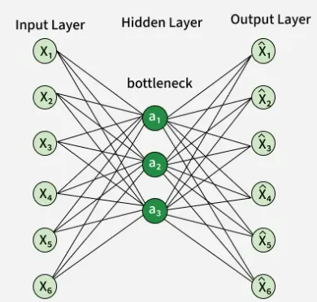

Anatomy of an Autoencoder
The Information Bottleneck
Autoencoders are multi-layer neural networks designed to reconstruct their own input through a compressed representation.
Layer L1 (Input): High-dimensional data features.
Layer L2 (Code): The bottleneck layer with reduced units, forcing the capture of "essential structure".
Layer L3 (Output): Reconstruction of L1, aiming for .

Slide 3
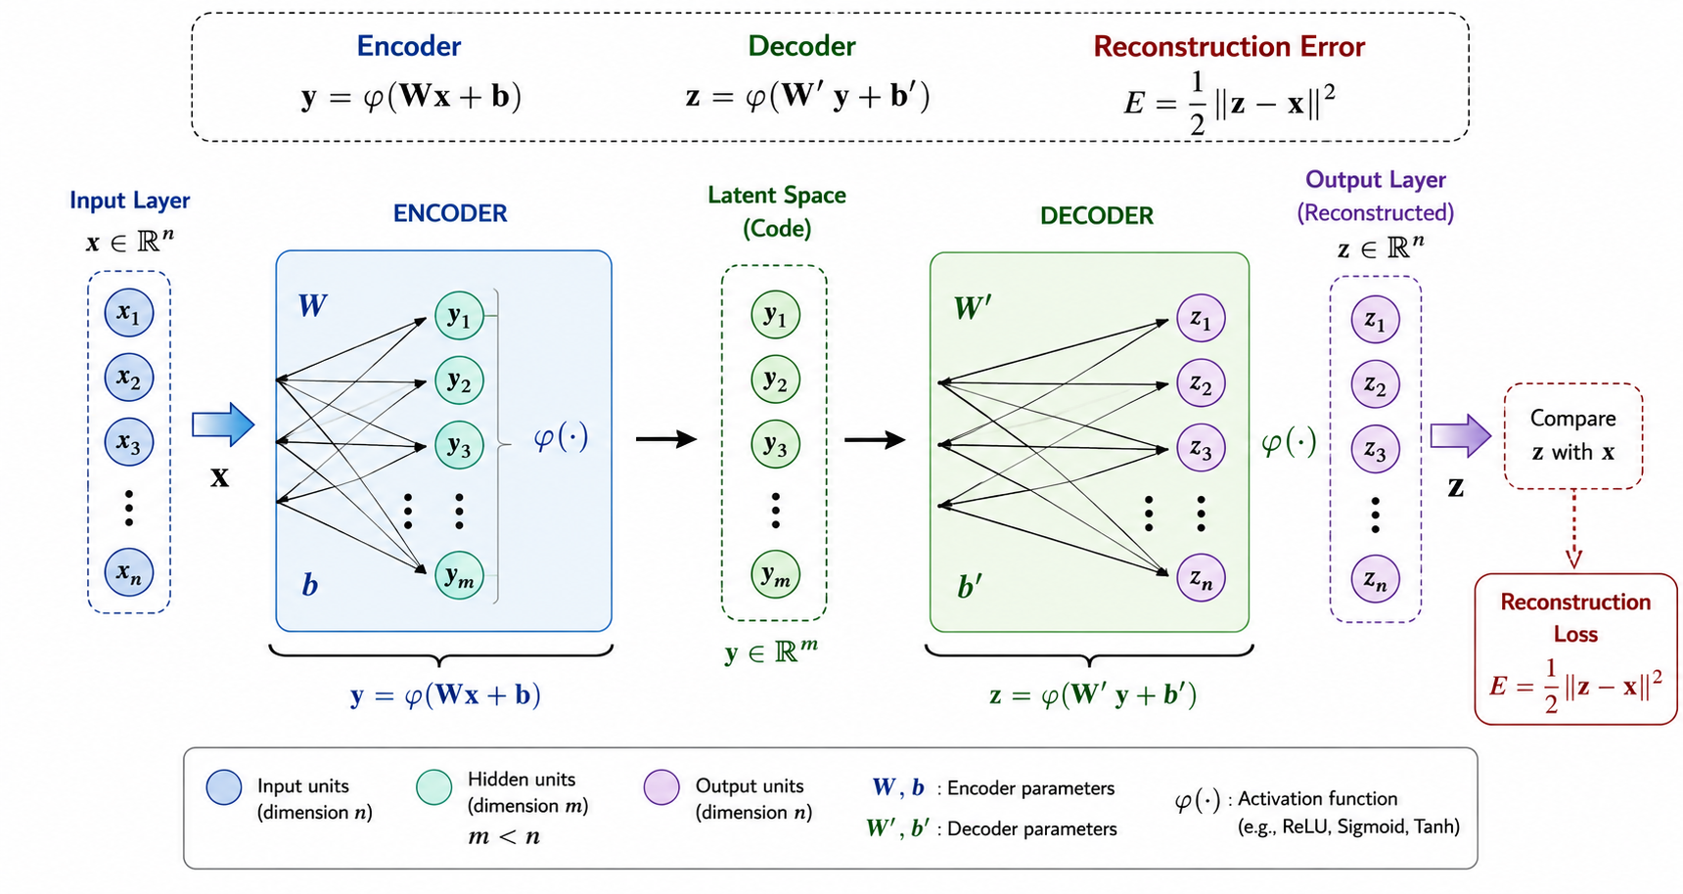

Slide 4
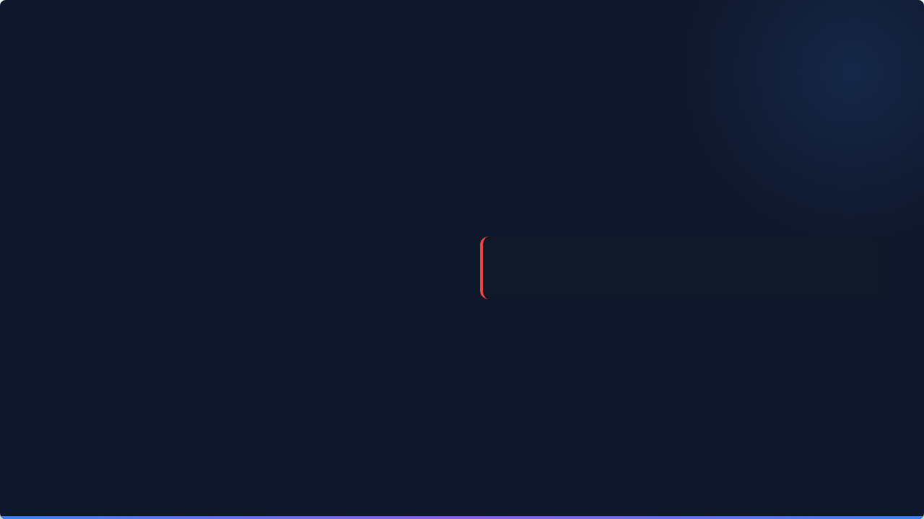


Reconstruction Optimization
Function Definitions
Objective Function
The network systematically maps data back and forth using activation functions (e.g., Sigmoid or Tanh):
Training minimizes the difference between input and output, often using Squared Error:
Encoder Activation:
Gradient descent is performed on this loss to learn weight parameters and biases .
Decoder Reconstruction:

Slide 5
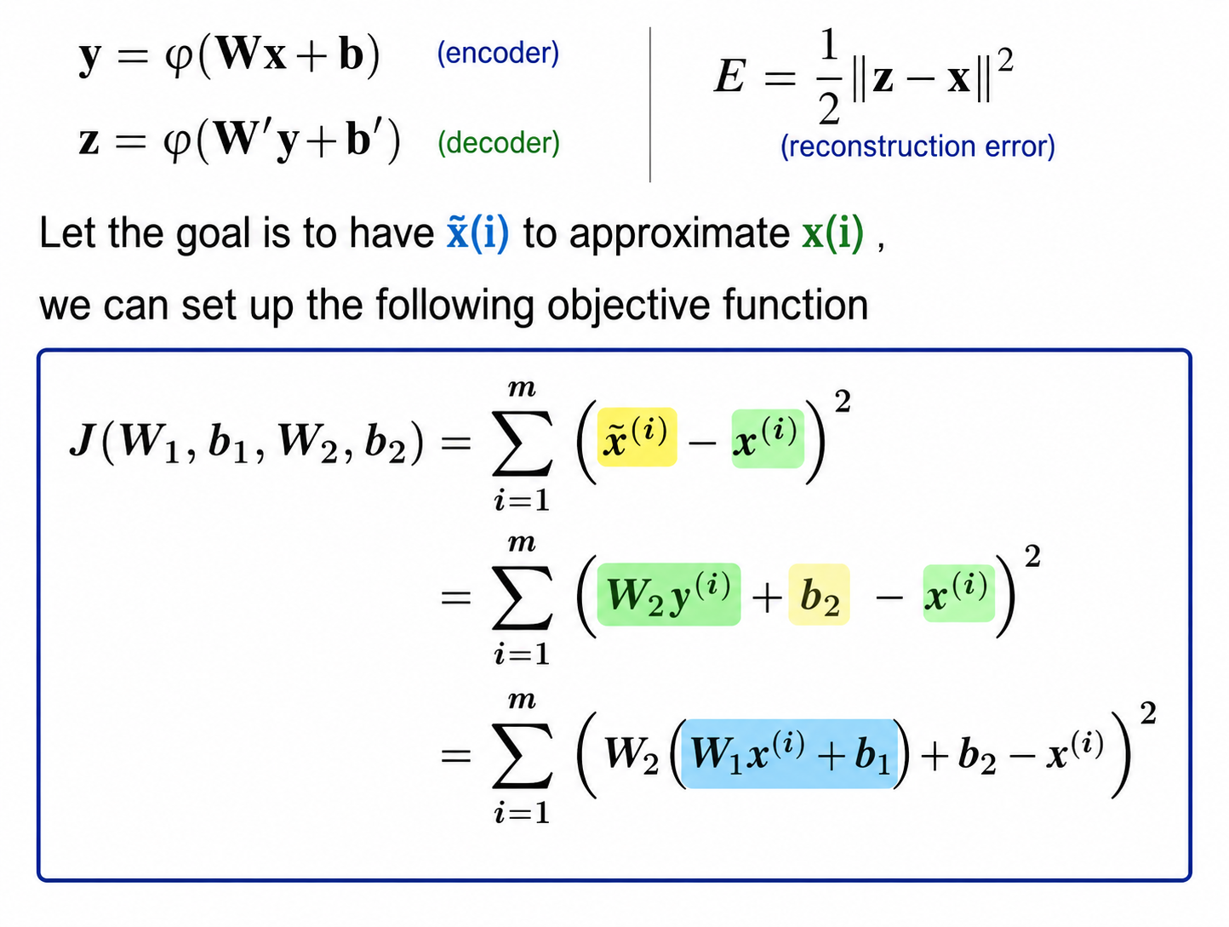

Slide 6
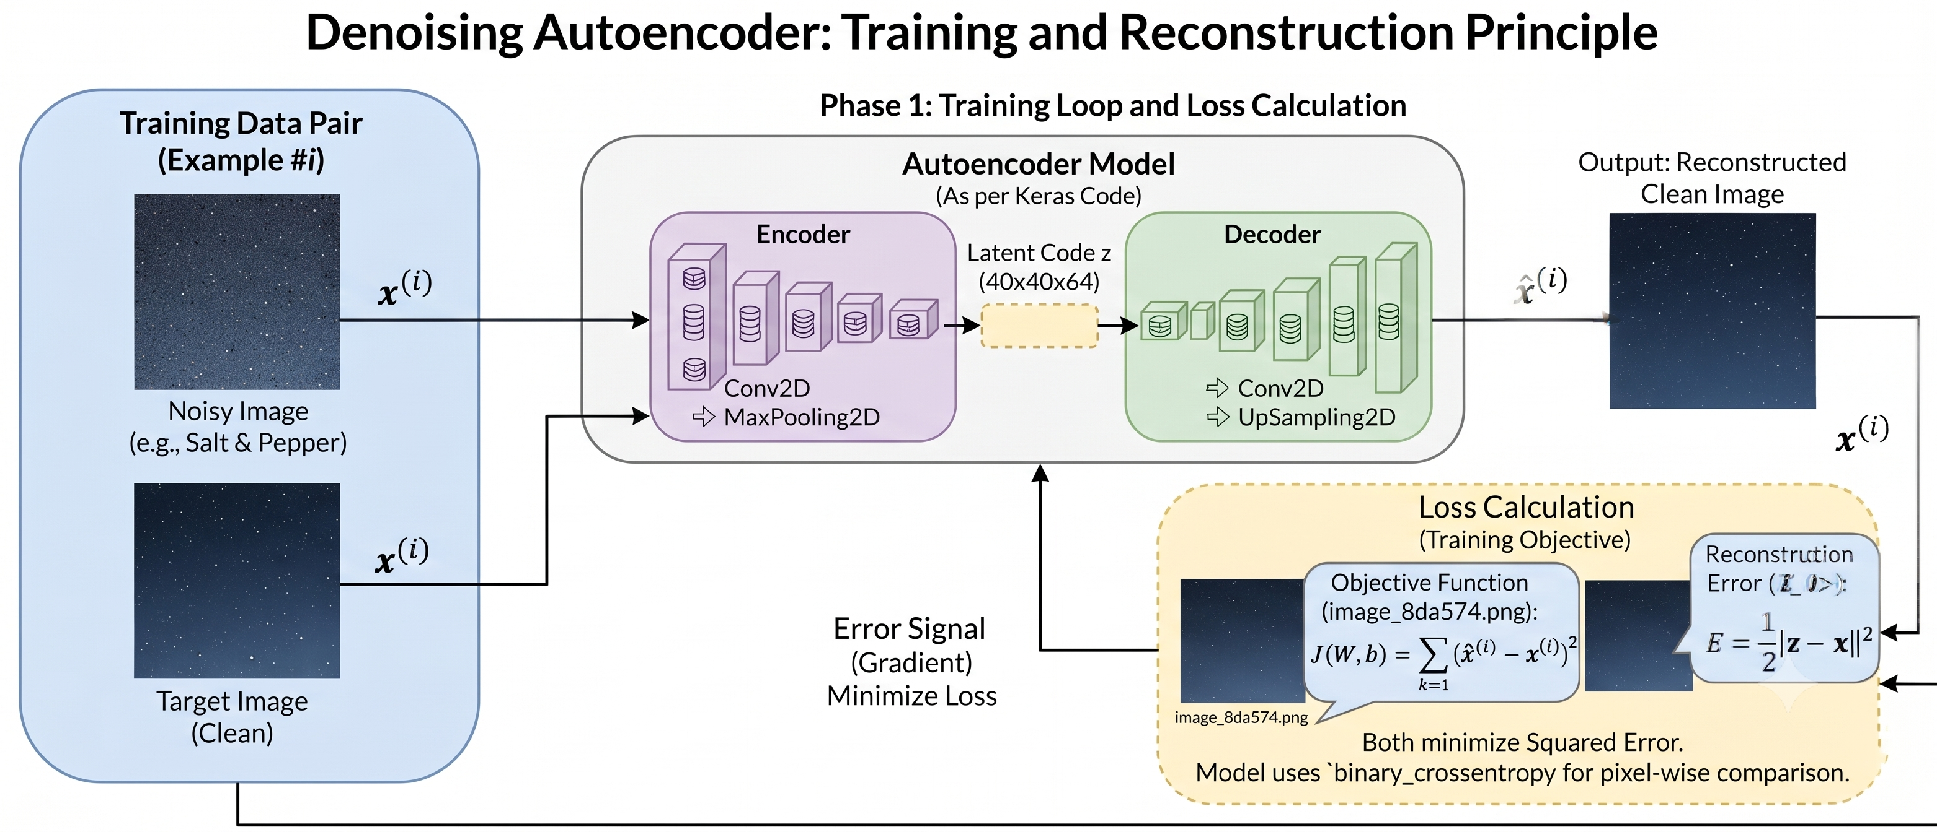
Robust Feature Learning
Denoising (DAE) Architecture
A DAE is trained to reconstruct the original clean input from a stochastically corrupted version .
Noise Injection: Input is corrupted via a function .
Latent Capture: Forces the model to learn stable dependencies and "un-corrupt" the data.
Reconstruction: Loss is calculated between the predicted output and the original clean input.

Slide 7
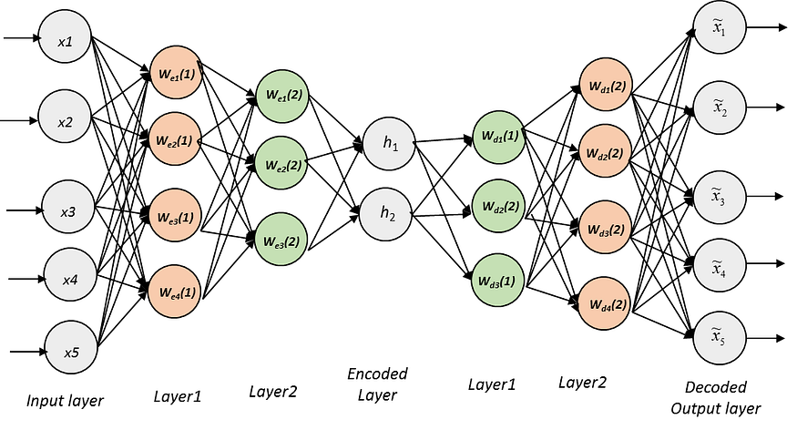
Stacked Autoencoders (SAE)
The Greedy Training Strategy
SAEs form a deep hierarchy where each layer receives input from the latent code of the layer below.
Layer-wise Pre-training: Each level is trained independently in an unsupervised fashion.
Latent Transfer: Once Layer 1 is trained, its encoder serves as input for Layer 2.
Weight Initialization: This provides a superior starting point for deep networks.

Slide 8
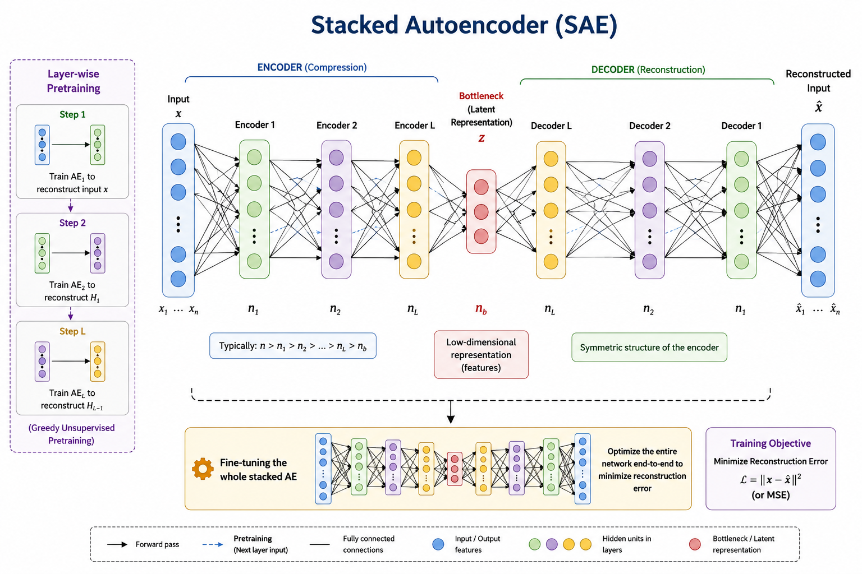

Slide 9






Supervised Fine-Tuning
1. Stack Encoders
2. Add Classifier
3. Global Tuning
Compose the pre-trained encoders into a single multi-layer stack, discarding decoder weights.
Append a target output layer (e.g., Softmax) on top of the final encoder representation.
Optimize the entire system using backpropagation to minimize supervised classification cost.
This hybrid approach leverages unsupervised data structure to boost supervised accuracy.

Slide 10
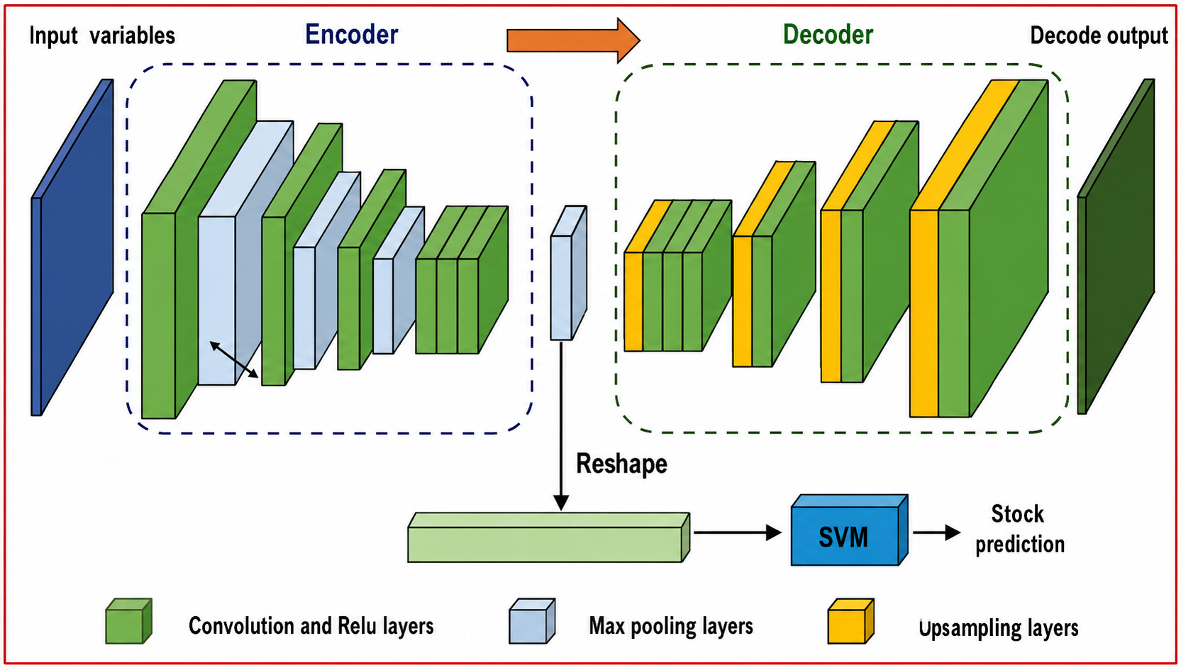

Slide 11

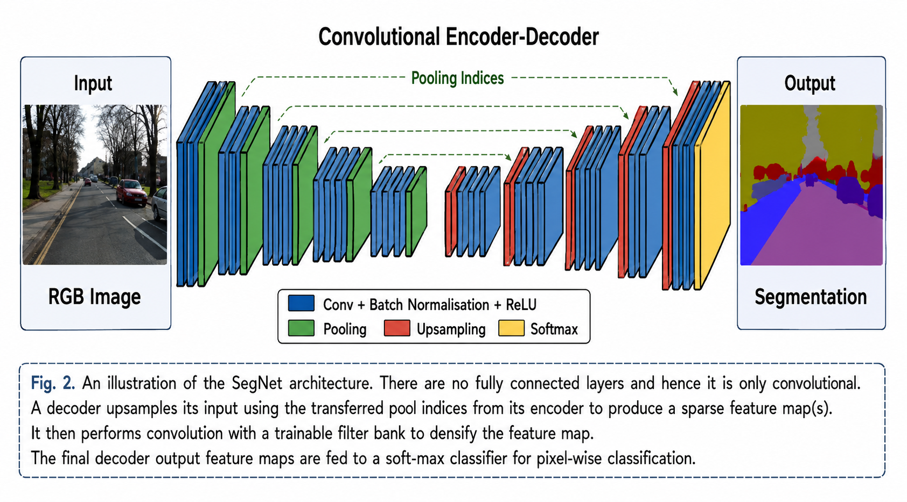

Spatial Encoding via CAEs
Convolutional Autoencoders
Specifically designed for image data, replacing fully connected layers with convolution and pooling operators.
Projection Operation:
Unpooling: Inverting pooling by distributing values back across spatial locations.
Weights: Filter weights are learned to extract visual patterns.

Slide 12
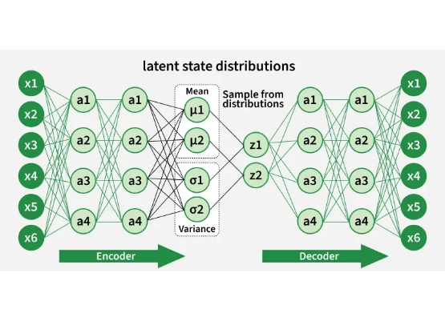
Probabilistic Synthesis: VAE
Stochastic Latent Variables
Unlike deterministic AEs, VAEs learn a probability distribution .
Encoder Outputs: Predicts both Mean and Std Dev .
Sampling: A latent vector is sampled to feed the decoder.
Generative Power: Sampling from the latent space creates new, synthetic examples.

Slide 13
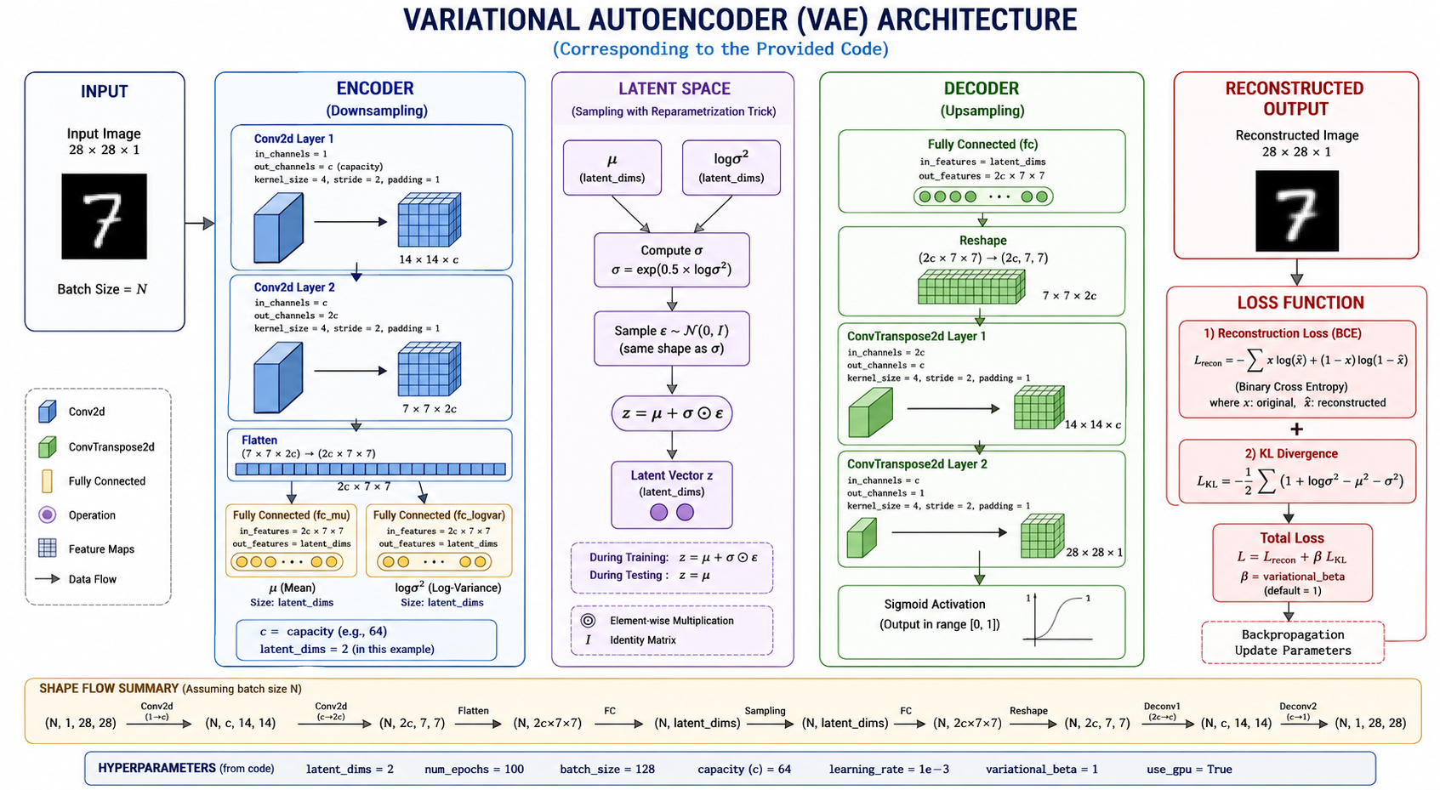

Slide 14
Architecture Comparison
Type | Primary Objective | Key Mechanism
Standard AE | Dimensionality Reduction | Information Bottleneck
Denoising (DAE) | Robust Feature Extraction | Reconstruction from Noise
Convolutional (CAE) | Spatial Image Analysis | Conv/Pooling Layers
Variational (VAE) | Synthetic Data Generation | Probabilistic Sampling

Slide 15
Questions?
Deep Learning Series: Autoencoders & Latent Spaces
Dr. Ahmed Yousry

